Slide 1
Detect Covid-19 via Chest X-Ray
Using convolutional neural network (CNN)
Ali Altamimi, Faisal Alasgah, 2x Ghanim, Omran

Slide 2
Table of contents
01
02
03
Description and Objectives.
Data Preparation.
Exploratory Data Analysis (EDA).
04
05
06
Modeling.
Tools.
Conclusion.

Slide 3
01
Description and Objectives.

Slide 4
Description and Objectives.
What is the problem?
Why do we need to work on it?
How are we approaching the problem?
Notes:
About Covid-19
Its impact
Time
Traffic
Smart city
Our purpose
To save lives

Slide 5
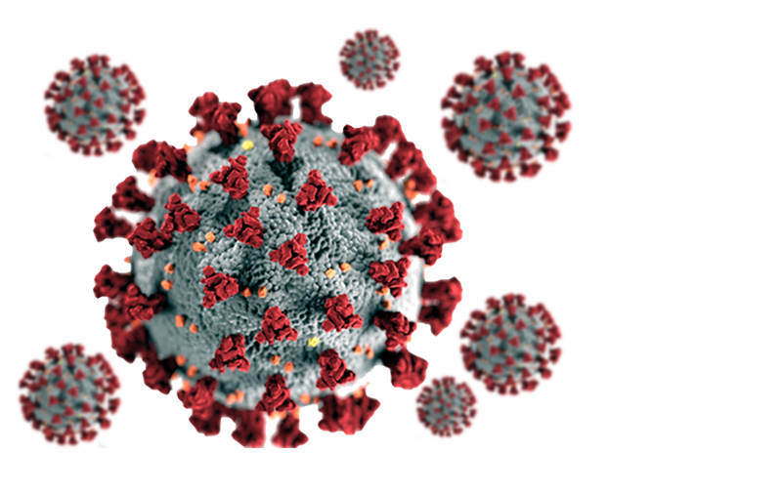
What is the problem?
The problem that we want to solve is Covid-19

Slide 6
Number of People Died
5.22M
World Wide!

Slide 7

As a Comparison
The number of people died by covid-19 virus is larger than the population of Kuwait!!

Slide 8
Description and Objectives.
What is the problem?
Why do we need to work on it?
How are we approaching the problem?
Notes:
About Covid-19
Its impact
Time
Traffic
Smart city
Our purpose
To save lives

Slide 9
02
Data Preparation.

Slide 10
Data Preparation
Source:
Kaggle
X-ray Images
Label
30,000

Slide 11
Data Preparation
Feature Selection
Data Cleaning
Feature Reduction
Dropped unwanted columns
Re-shape the images
10,000 data rows

Slide 12
The Final Dataset
After applying multiple techniques to prepare the dataset, we end up with:
9,000 Images for Training.
1,000 Images for Validation.
400 Images for Testing.

Slide 13
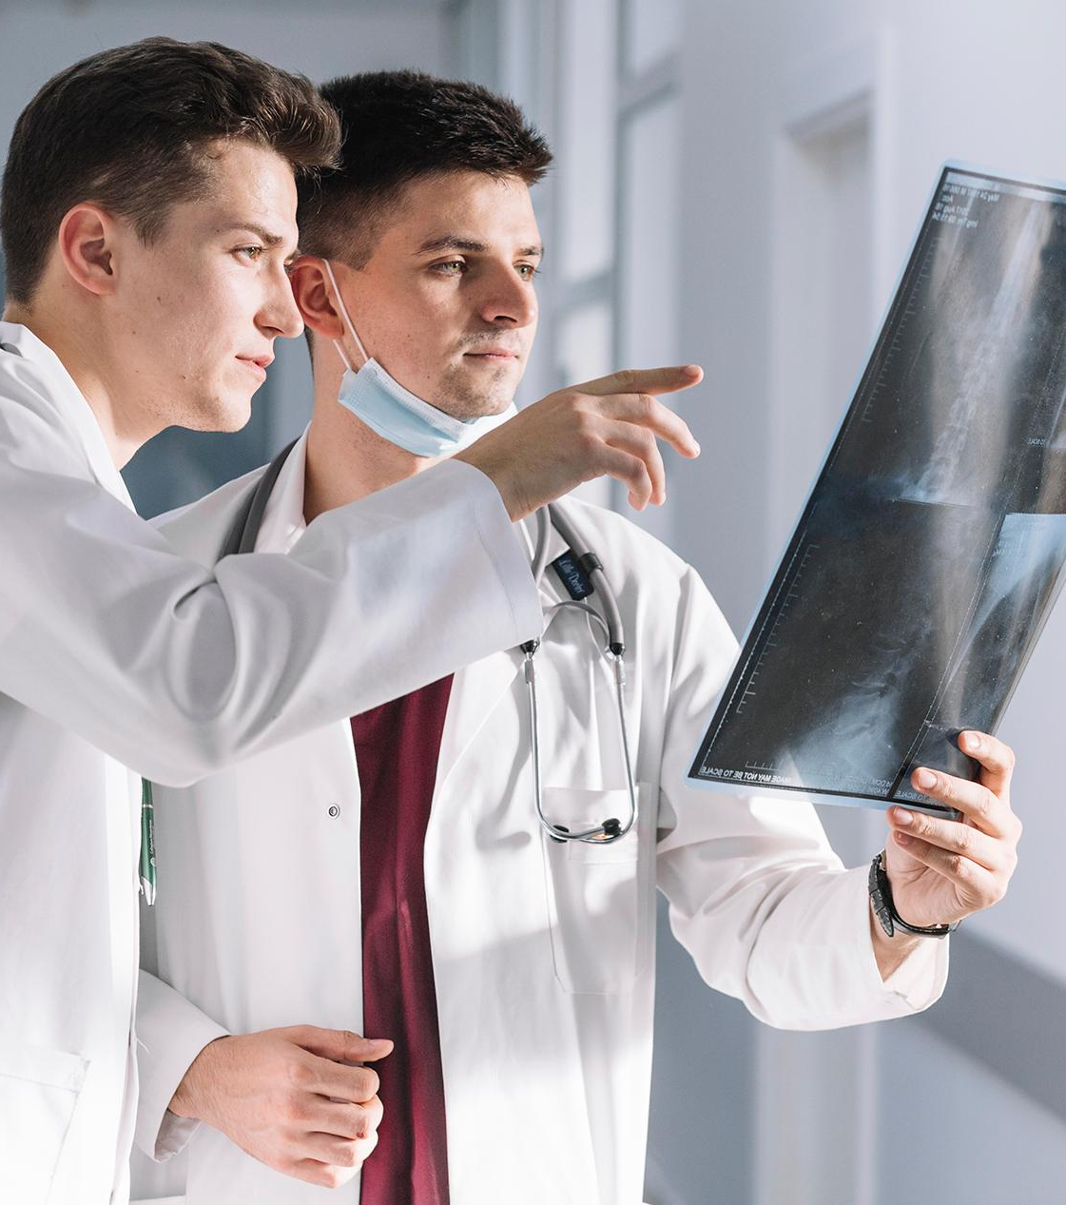
03
Exploratory Data Analysis (EDA).

Slide 14
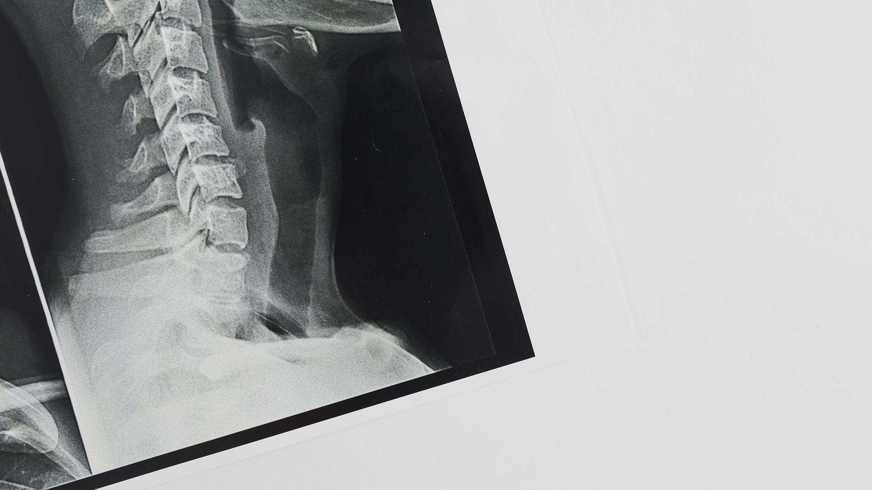
A picture is worth a thousand words

Slide 15
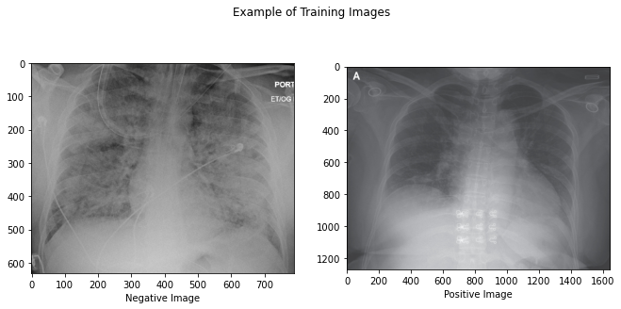
Data Sample

Slide 16
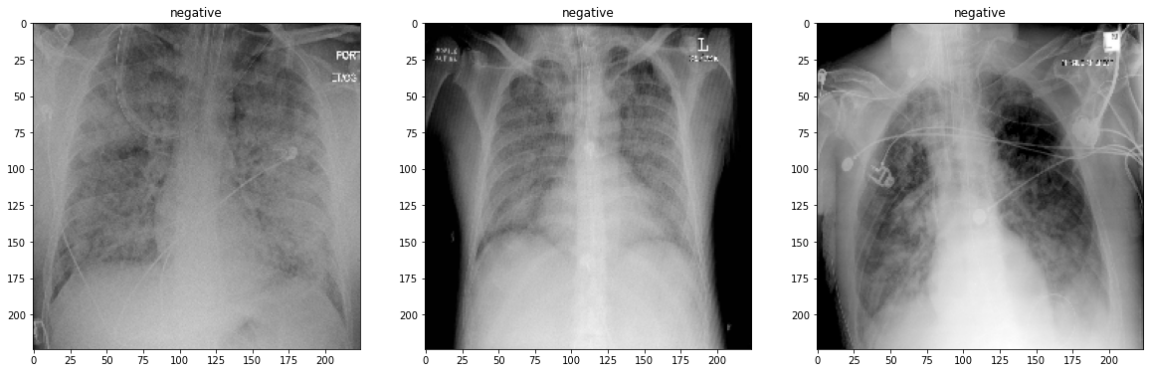
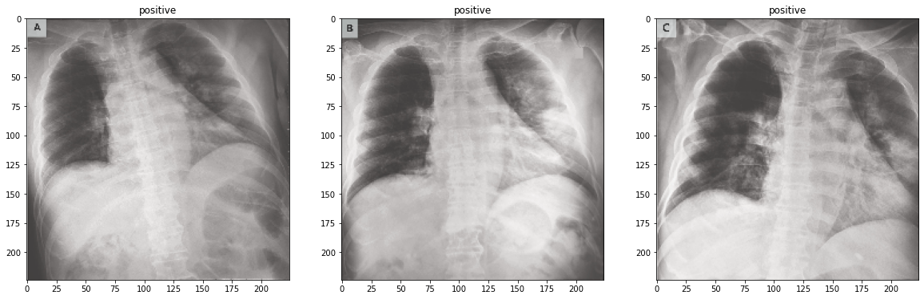
Image preprocessing

Slide 17
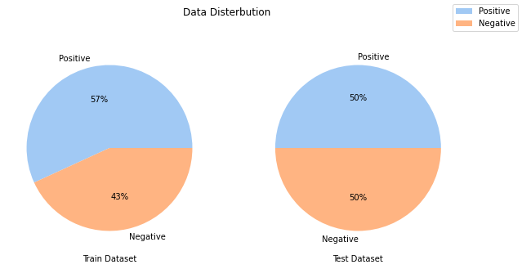
Data Distribution

Slide 18
04
Modeling.

Slide 19
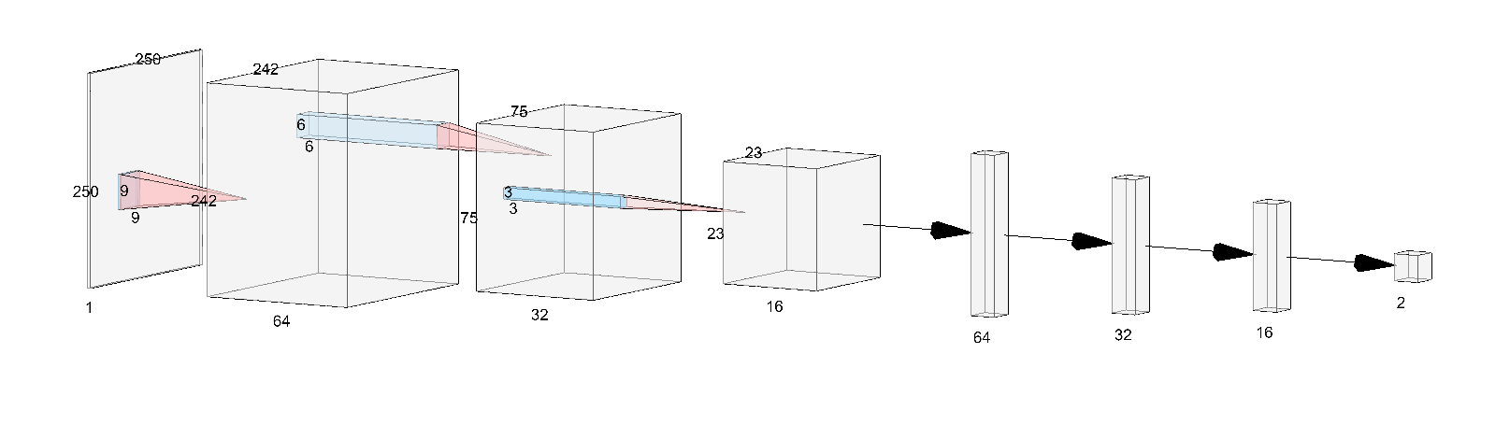
Model

Slide 20
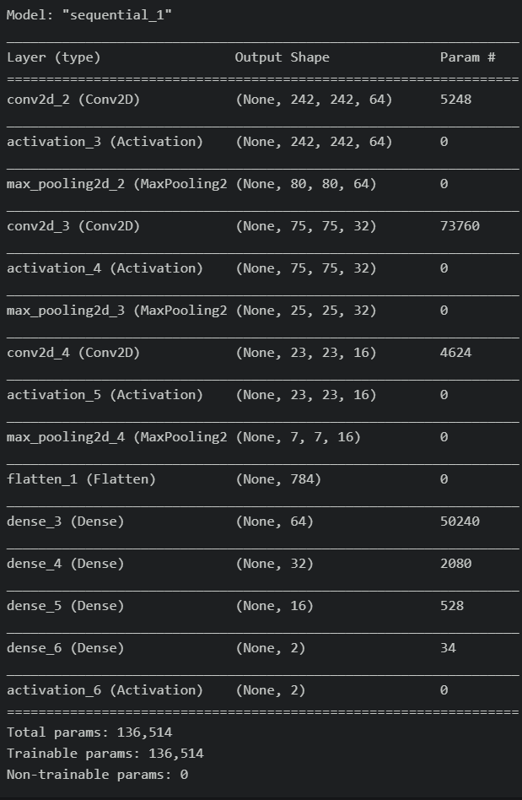
Summary

Slide 21
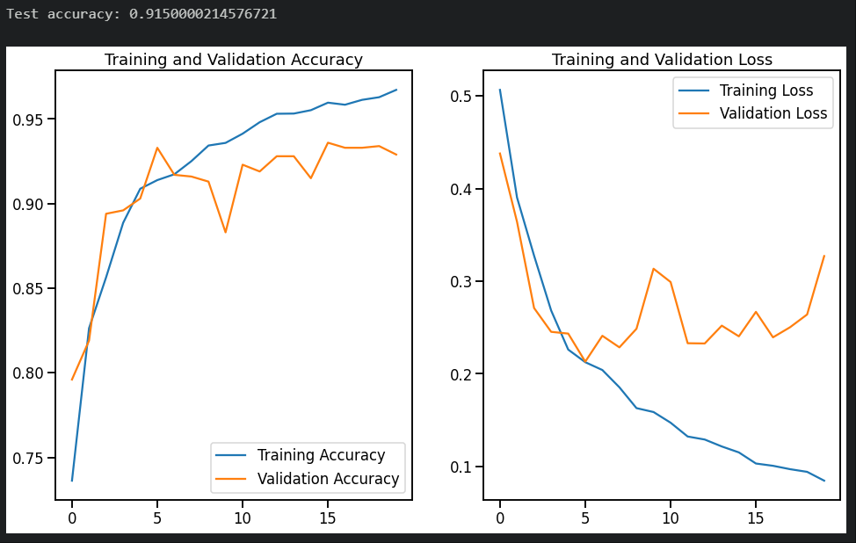
Model

Slide 22
05
Tools.

Slide 23
Tools
Pandas
Tensorflow
Seaborn
Sklearn
Numpy
Is used for loading data and handle data structure
Used for deep learning
Used to visualize data
Used to test the the result
For mathematical operation

Slide 24
Conclusions
The problem of covid-19
Our data and its preparation
The model and result

Slide 25
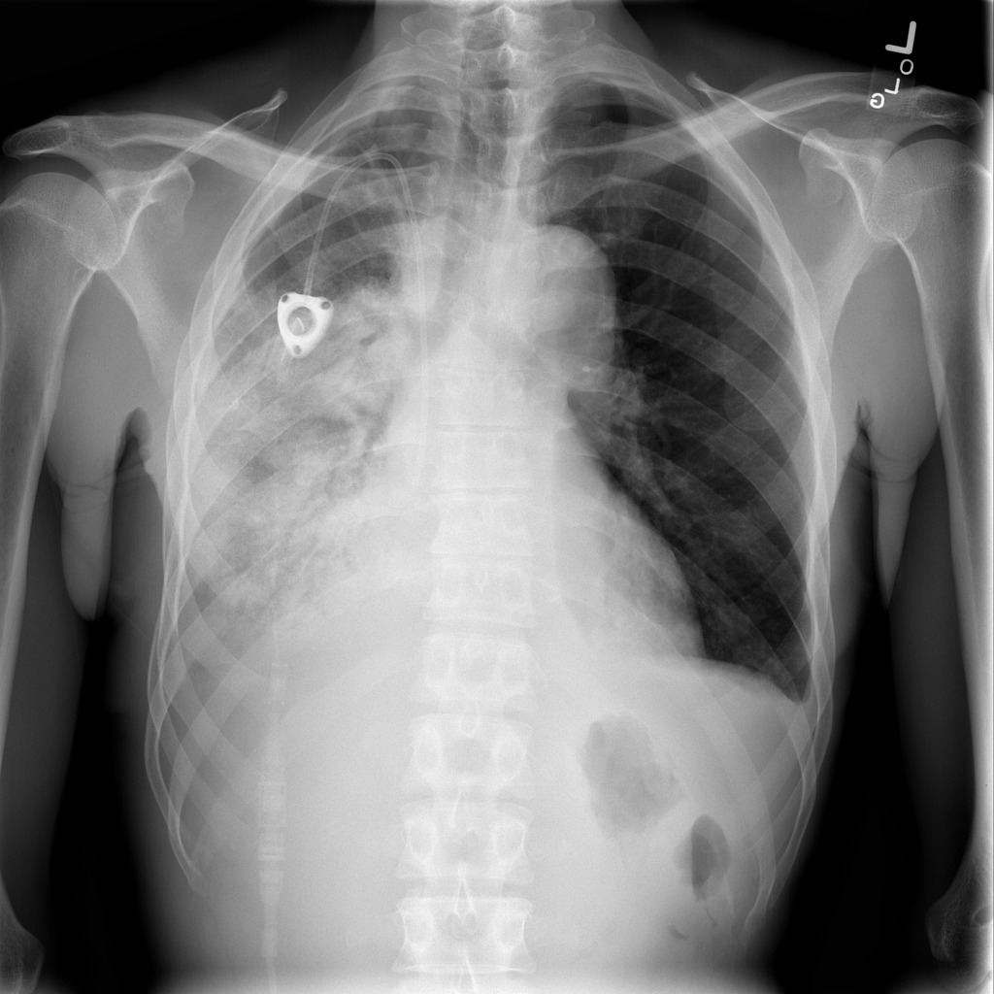
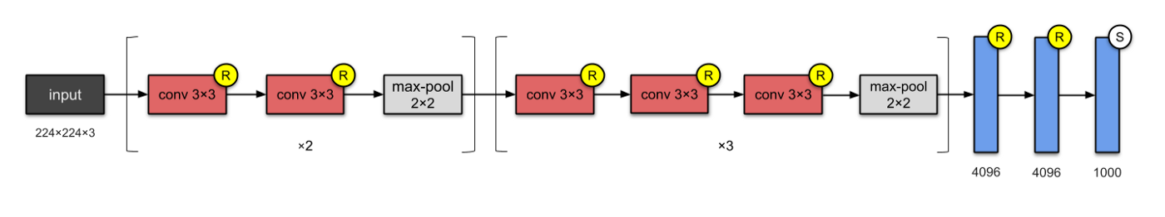
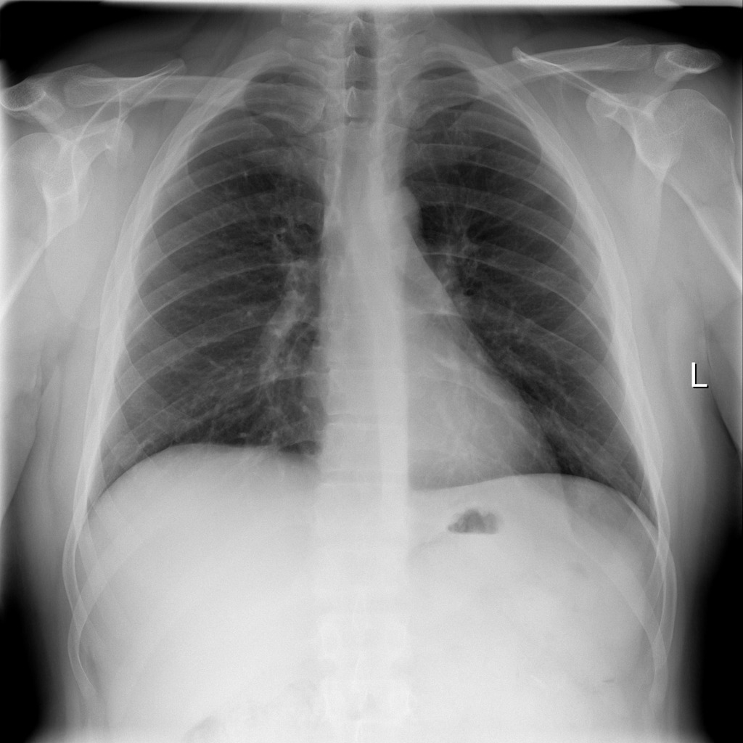
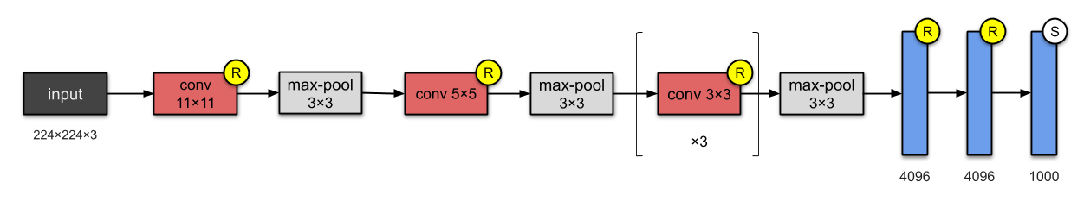
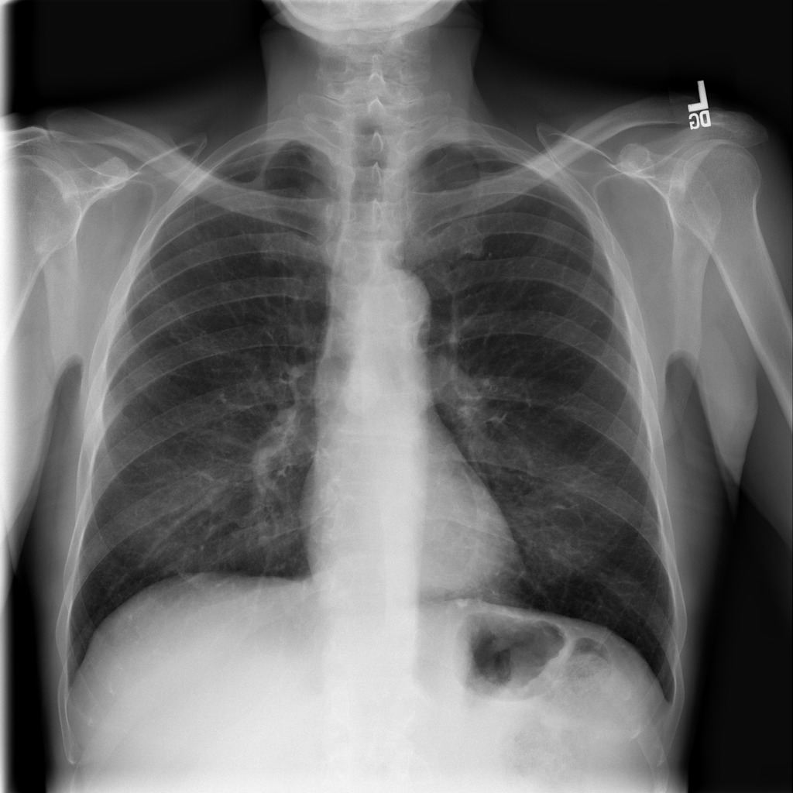
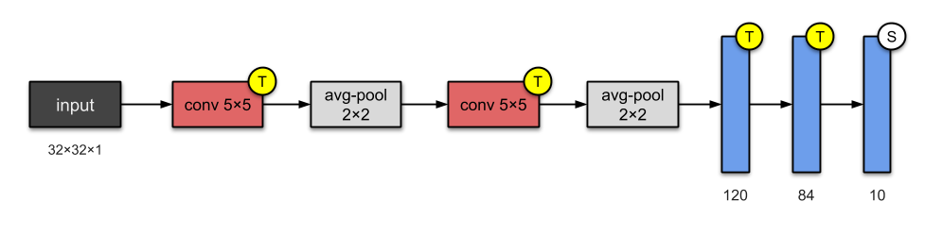
Recommendations
This model can be used as an advising tool.
Detect multiple diseases
Test different architecture to have better scores.

Slide 26
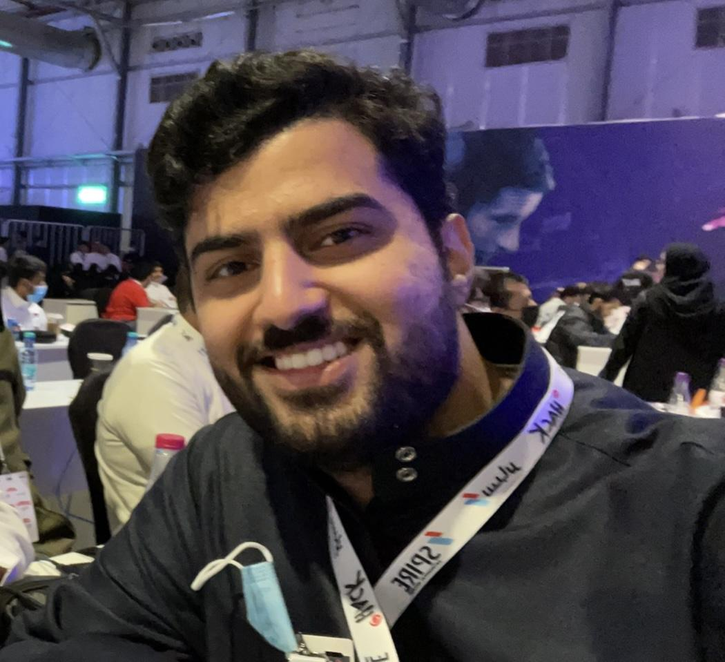

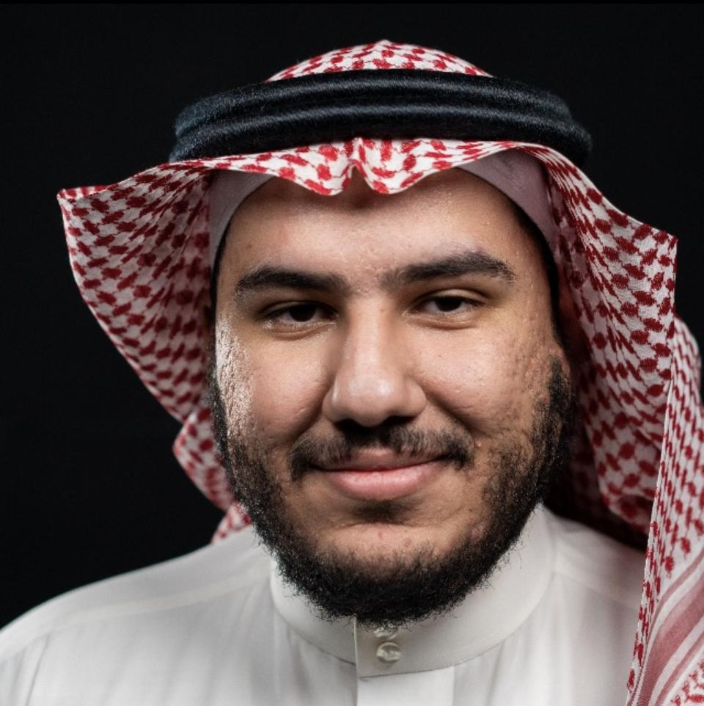
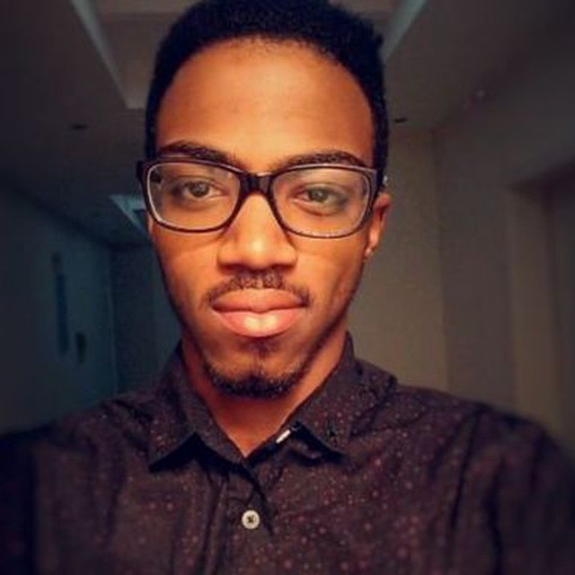
Our team
Ali Al-tamimi
Faisal Alasgah
2x Ghanim
Omran Fallatah

Slide 27
Thanks!
Any questions?

